Slide 1
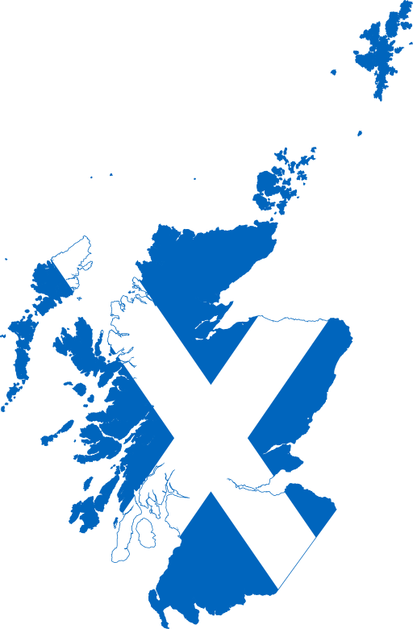
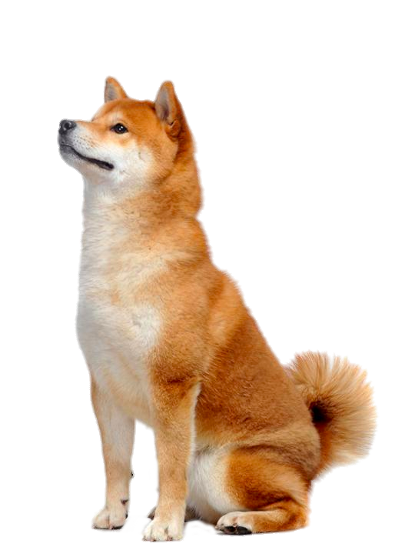
An insight into hospital admissions data in Scotland
Veronika, Michael & Matt (& Lyova)
Notes:
Welcome, so, what are we going to be looking at? we have built our dashboard to give an insight in to hospital admissions data in Scotland.
Don’t forget the doggo!
VM notes:
Hi everyone, our group project was about an insight into hospital admissions data in Scotland focussing on alcohol problem. Using open data from Scottish government and NHS, me, Michael and Matt built a dashboard which will be demonstrated later by one of my team mate.

Slide 2



Agenda
Planning and working as a group
Demonstration and metrics
Summary and conclusion of app
Conclusion of working in a group
Questions
Notes:
Process of collaboration
Demonstrating the app
VM notes: We are going to speak about planning and working as a group. What tools we used and how efficiently.
Then the dashboard will be demonstrated discussing features and metrics.
Finally we will finish by summarising and concluding the app and how it was working in the group.
And questions at the end.

Slide 3
1. The planning stage
Here’s how we planned out the project and the tools used...
Trello
Excalidraw
Zoom
Slack
And stating the obvious….R Studio
Notes:
VM notes:
For planning and actually moving the project ahead, we used different tools such as Trello as an organising tool, excalidraw for visualisation of the dashboard, zoom and slack for communicating and obviously the R studio. I believe that that we were the only group who was always online as we never met in real life to work on the project. So bear in mind that everything was done online.

Slide 4
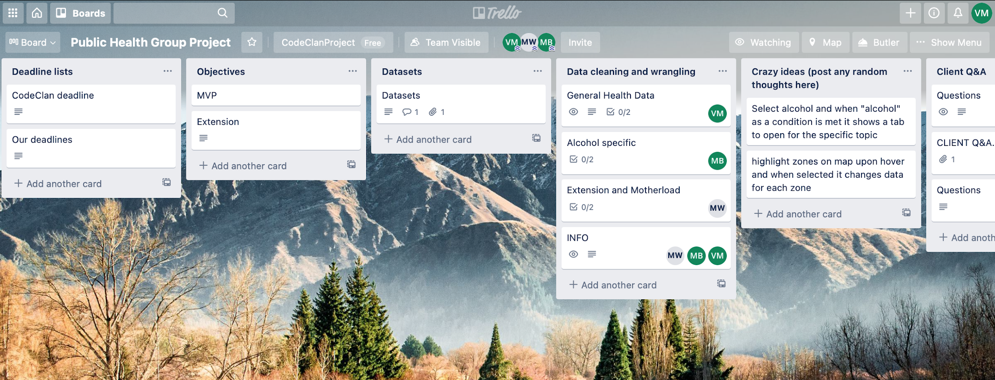
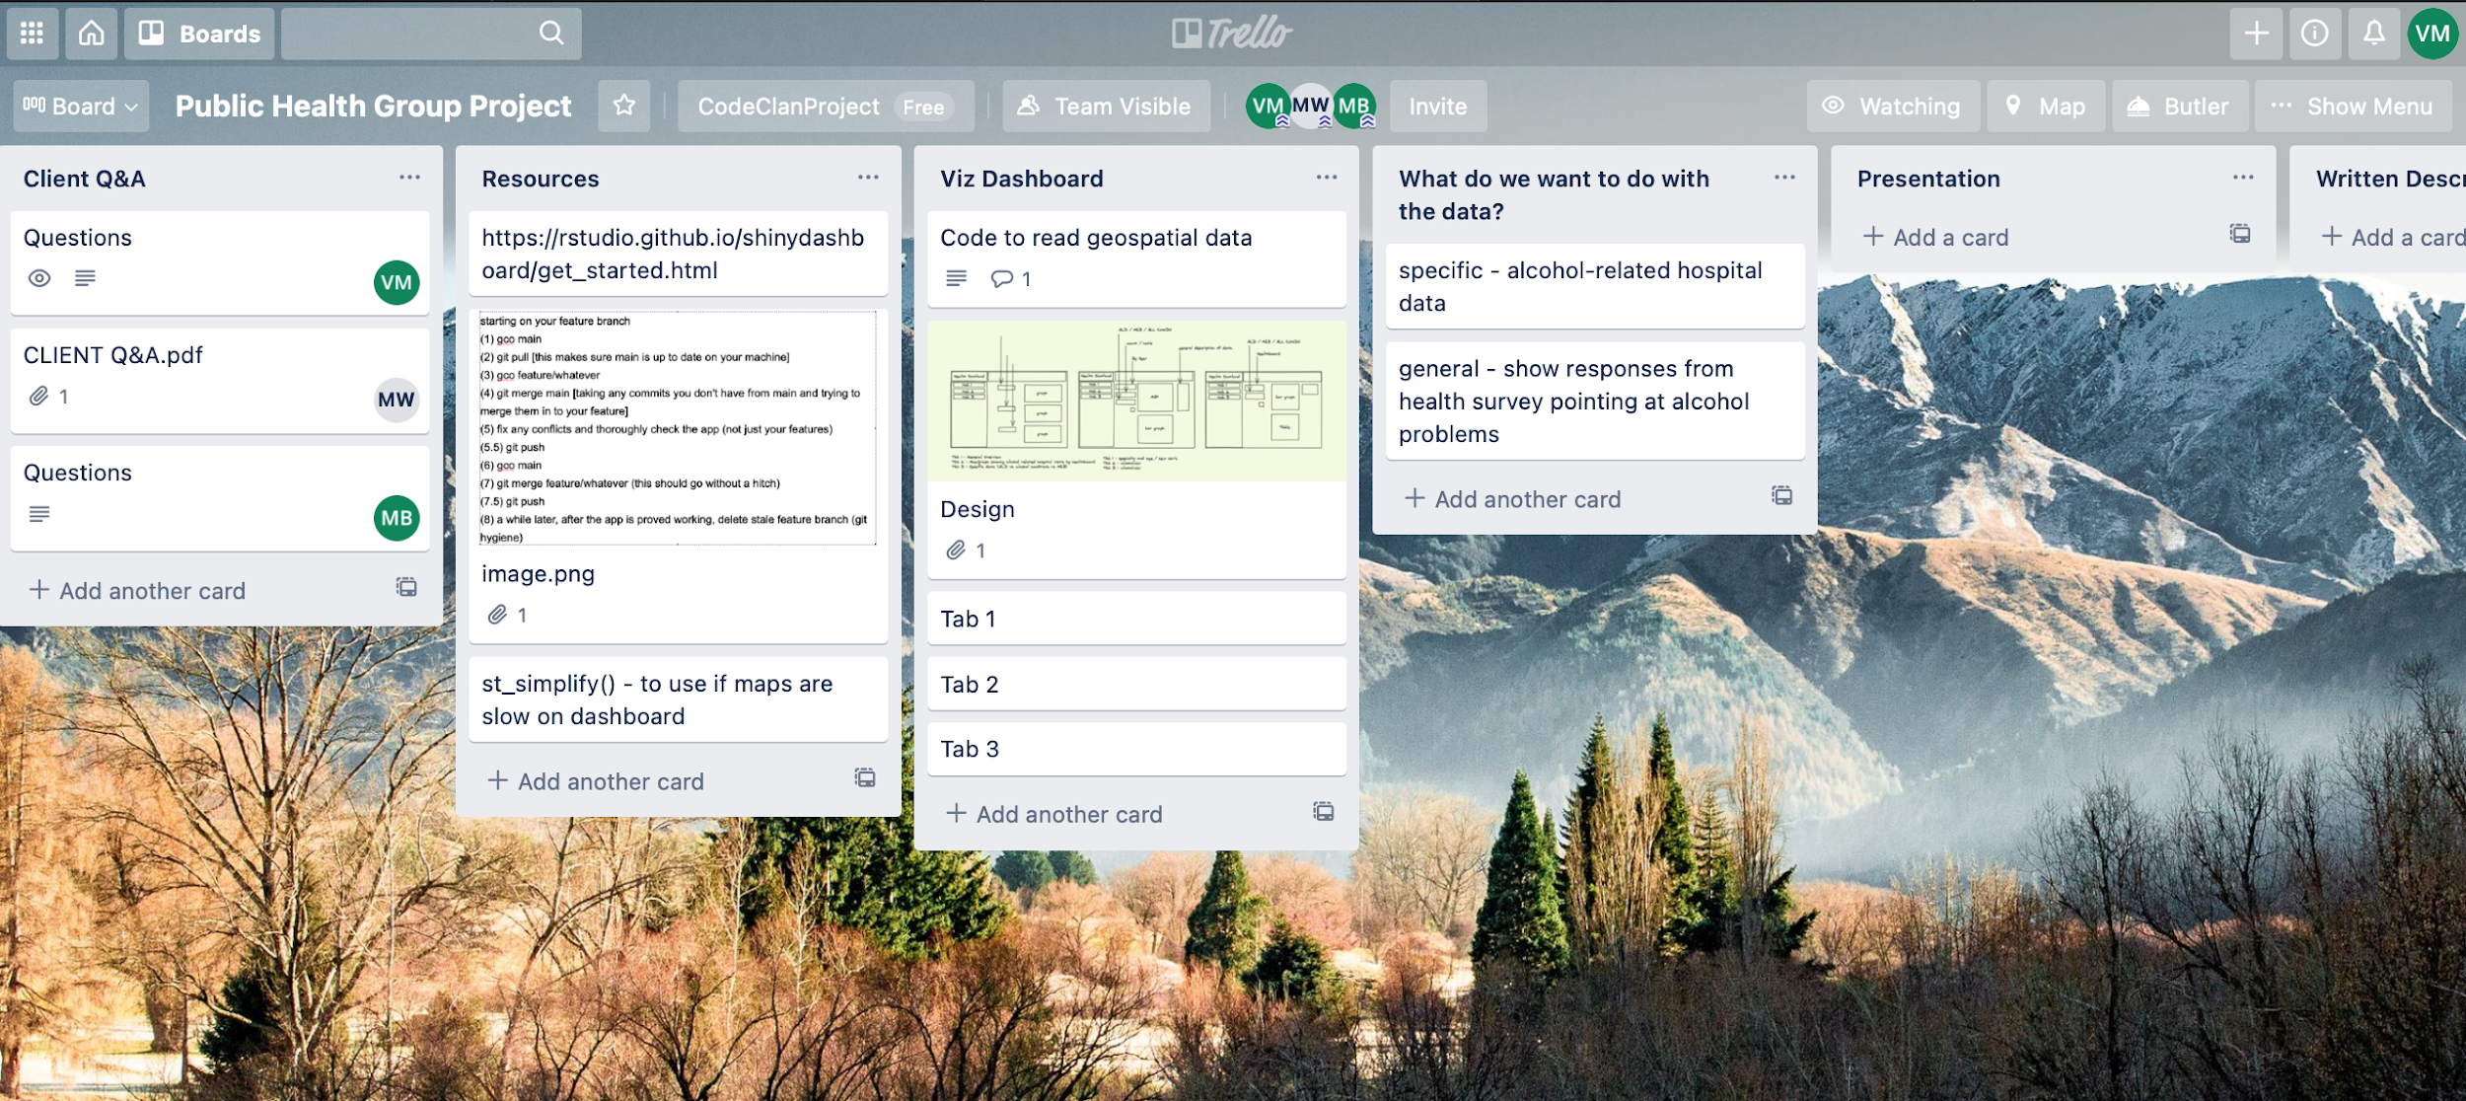
Trello
Primarily, we used Trello as a storage for resources and some initial task management planning.
Notes:
VM notes:
Trello was very useful tool for storaging and keeping useful information to get it quickly.
To be honest, trello was mostly used at the beginning of the project and then towards the end of the project, we did not use enough and could have used it more and most of the stuff was done through slack/zoom.
But still it was very useful, for example, we had codeclan and our deadlines, objectives for MVP and extension
All links to the open datasets, data wrangling assigned individually for the weekends, crazy ideas which we were managed to achieve, client questions by each of us, useful resources and so on.

Slide 5
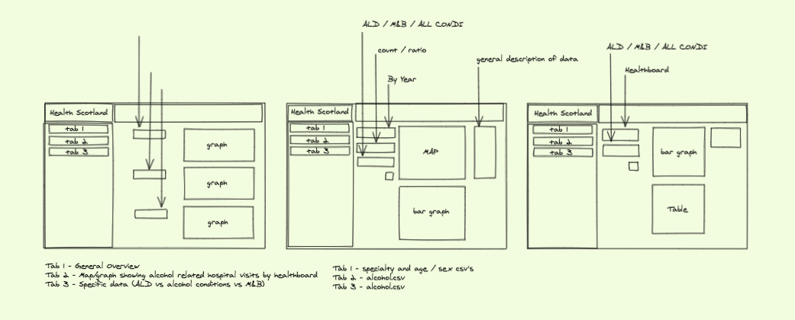
Excalidraw
We used Excalidraw to help plan and visualise our dashboard before building it in Shiny.
Notes:
MB: We all really liked Excalidraw. It was a tool that we spent a fair bit of time on, discussing how we wanted the design of our app to look. We didn't go for too crazy a design, we wanted to keep it fairly simple so that we could have a chance to change things when it came to the actual creation of the app if things were not to our liking. Since this is the first time we have all worked on a project like this one, the end goal was somewhat unknown so keeping things simple seemed like a good idea, and to expand them as we went. If we were to do another project like this one in the future, the planning stage would be easier, with some prior knowledge of how a project like this would play out would allow for maybe a more set design.

Slide 6
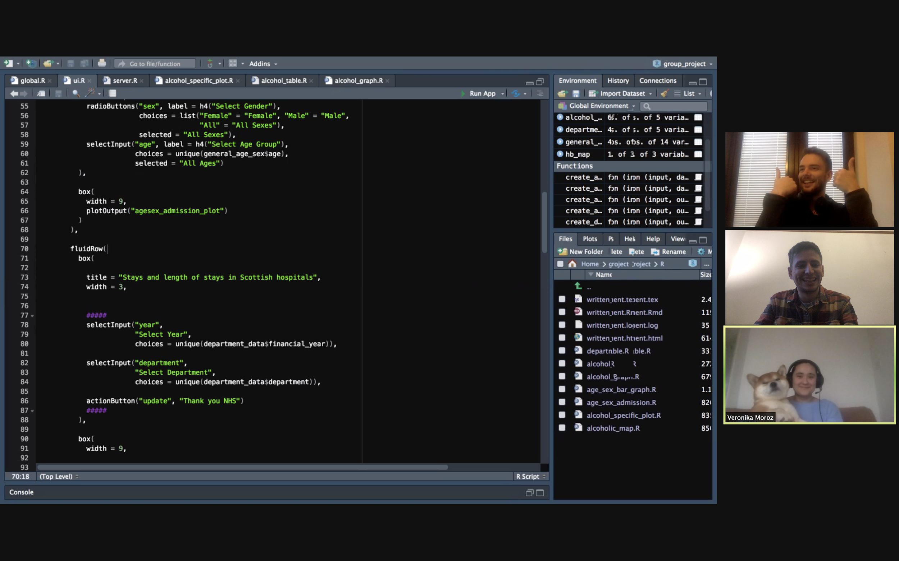
Zoom
We used Zoom for daily meetings and collaborative working.
Doggo
Notes:
As Veronika mentioned earlier, we worked almost entirely remotely between the 3 of us. Using Zoom for collaborative working, it did mean we spent a lot of time on Zoom which was sometimes tiring, but we did have our 4th team member for cheering us up.

Slide 7

Slack
We used Slack for quick link shares, sharing code and arranging any calls/meetings.
Notes:
MB: slack was a tool that we used to mostly share links but we also

Slide 8
2. The app
An overview of hospital admissions data in Scotland.
Specific exploration of hospital data related to alcohol intake admissions including mental health related admissions.
Notes:
So now onto the app, firstly we decided to look at an overview of hospital admissions in Scotland and then we wanted to explore alcohol related admissions more specifically, this includes alcohol admissions relating to any mental health issues as well.

Slide 9
3. Learning and outcomes
Next time, we will be better at task management and delegation
Zoom enabled us to work collaboratively and minimise technical errors
To deliver on project, we made sacrifices to the team dynamic
Experience will help us to move forward for next time
Notes:
Yesterday after we finished everything we had a great review of how each of us felt the project went in terms of group working and we decided we would share the outcomes of that conversation.
*Michael speaks* - Because this was a new experience none of us took a lead on the project overall. At different stages we took charge for planning on trello and with our presentation itself, mathew was primarily in charge. Veronika took charge when it came to creating our graphs and the planning of the structure of our project was primarily done by myself.
We spent all day on Zoom and although that was tiring at times, and probably not the most effective for task management and delegation, it did mean that when it came to things like merges, we had zero errors and conflicts.
Sacrifices to the team dynamic, well. It was fine that we had issues, as we are all at different abilities. There were times where I fell behind on the technical coding to be efficient with the timing.
And obviously all experiences help us to learn and move forward to improve the next time.

Slide 10
Any questions?
Sorry...Lyova is unavailable for questions as he is too busy being a doggo!
Notes:
Sorry guys, Lyova, is unavailable for questions at this time too busy being a doggo.

